Slide 1
Conceptual Data Models
Brainstorming your data structure
1.2

Slide 2
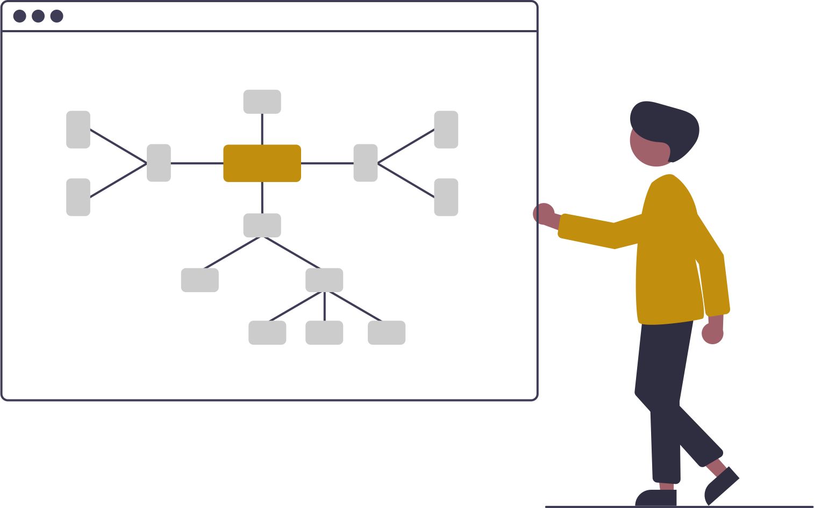
Entities & Relationships
With a list of entities in hand, it’s time to determine relationships

Slide 3
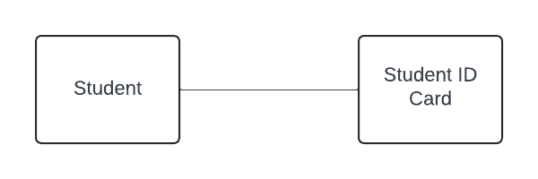
Relationship Types
1:1 (“One to One”)
Exactly ONE instance of an entity has a connection with exactly ONE instance of another entity
Somewhat rare in the database world
1:* (“One to Many”) (also denoted as 1:N)
One instance of an entity is connected to multiple instances of another
Most common relationship type
*:* (“Many to Many”) (also denoted as M:N or N:N)
Multiple instances of an entity are affiliated with multiple instances of another
Difficult to store as *:* in a relational database

Slide 4
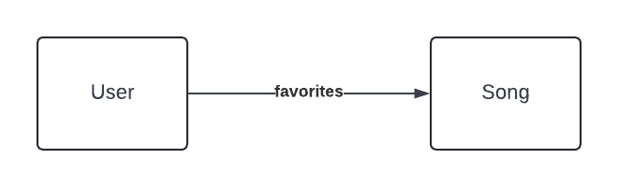
“Implied” Entities
Read between the lines
Use relationships to help discover additional entities
User
Song
ID | Email
0001 | fred@yahoo.com
0002 | ahmed@gmail.com
ID | Title
0001 | Rihannon
0002 | Layla

Slide 5
“Implied” Entities
Read between the lines
User 0001 favorites Song 0001
User
Song
ID | Email | Favorite
0001 | fred@yahoo.com | 0001
0002 | ahmed@gmail.com
ID | Title
0001 | Rihannon
0002 | Layla

Slide 6
“Implied” Entities
Read between the lines
User 0002 favorites Song 0001
User
Song
ID | Email | Favorite
0001 | fred@yahoo.com | 0001
0002 | ahmed@gmail.com | 0001
ID | Title
0001 | Rihannon
0002 | Layla

Slide 7
“Implied” Entities
Read between the lines
User 0001 favorites Song 0002
User
Song
ID | Email | Favorite1 | Favorite2
0001 | fred@yahoo.com | 0001 | 0002
0002 | ahmed@gmail.com | 0001
ID | Title
0001 | Rihannon
0002 | Layla

Slide 8
“Implied” Entities
Read between the lines
User 0001 favorites Song 0002
User
Song
ID | Email | Favorite
0001 | fred@yahoo.com | 0001
0001 | fred@yahoo.com | 0002
0002 | ahmed@gmail.com | 0001
ID | Title
0001 | Rihannon
0002 | Layla

Slide 9
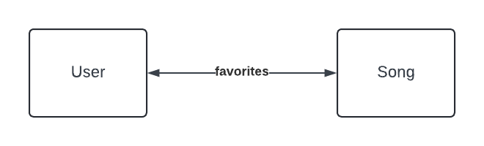
“Implied” Entities
Read between the lines
We actually have a many-to-many (*:*) relationship

Slide 10
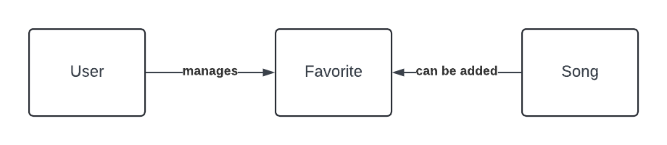
“Implied” Entities
Read between the lines
Add an implied entity (“join table”) to marry a many-to-many relationship
User
Favorite
Song
ID | Email
0001 | fred@yahoo.com
0002 | ahmed@gmail.com
UserID | SongID
0001 | 0001
0001 | 0002
0002 | 0001
ID | Title
0001 | Rihannon
0002 | Layla

Slide 11
Creating a Conceptual Data Model
CDM

Slide 12
CDMs are…
a brainstorming tool
intended to be easily digestible
a snapshot of your understanding of the entities and relationships underlying the system
malleable (not set in stone)
a tool for understanding and explaining business processes in layman’s terms
language should be plain and clear
NOT FORMAL, but should be readable and easy to follow

Slide 13

Pieces of a CDM
Boxes
Plain language
Singular noun/concept
Arrows
Arrowhead denotes relationship
1:1
1:*
*.*
Descriptors
Plain language description of relationship
Brightspace Account
Instructor
affiliated with
teaches
Student
Course
enrolls

Slide 14
Back to the Implied Entities!
Student
Course
ID | Email | Course
0001 | jose@purdue.edu | 0001
0001 | jose@purdue.edu | 0002
0002 | mindy@purdue.edu | 0001
ID | Title
0001 | MGMT 58200
0002 | MGMT 59000

Slide 15
*:* Means to Look for Implied Entities
Student
Course
enrolls

Slide 16
*:* Means to Look for Implied Entities
Student
Enrollment
Course
creates
contains

Slide 17
Begin to Think About Unique Identifiers
Student
Enrollment
Course
creates
contains
PUID
Generic ID
PUID
Course Number
Semester
Course Number

Slide 18
Drawing the CDM

Slide 19
“Rules” for Drawing a CDM
There are no rules (brainstorming)
BUT there are guidelines
Boxes & arrows & descriptors
Assessment of CDMs
Quality of entities
Do they capture necessary functionality? Do they include implied entities?
Directionality of relationships
Do the relationships accurately denote the interactions?
Descriptors
Specifically relate to business processes
Readability and intelligibility
Although it’s for brainstorming, you will use this to exchange information with others

Slide 20
Tools for Drawing CDMs
Recommendation: Use a drawing tool that will also draw Entity Relationship Diagrams (ERDs) (next week)
👍 Draw.io (drawio.com)
Free; no account required
🚨Must save file locally🚨 – does not store online automatically
👍 Lucidchart (lucid.app)
Sign in with your @purdue.edu email address for free access
You WILL run into limits on the free version (but it will work for this course)
🖐️ Microsoft Visio desktop (available on Community Hub)
WINDOWS ONLY
Overkill for this course (might be used in other courses)
👎 Microsoft Visio web
NOT recommended
Free version DOES NOT include ERD notation

Slide 21
Draw.io Demo

Slide 22
Individual Assignment: Circuit Peer Review Tool
Assessing the first Individual Assignment
The first individual assignments will have a series of steps:
Download your randomized system request
Create your Conceptual Data Model (CDM)
Upload your CDM to the Circuit peer review tool
Calibrate your reviews (3)
Conduct peer reviews of three other students
Conduct a self review of your work after you’ve viewed other student work
Due FRIDAY night (11:59pm)
25%
Due FRIDAY night (11:59pm)
40%
Due MONDAY night (11:59pm)
25%
10%

